Slide 1
BASIC Human ASPIRATIONS
Name: VAKA PRASANNA
Roll No: 20BQ1A05O6
Subject: Universal Human Values
Section: 4-CSE-D
College: Vasireddy Venkatadri Institute of Technology

Slide 2
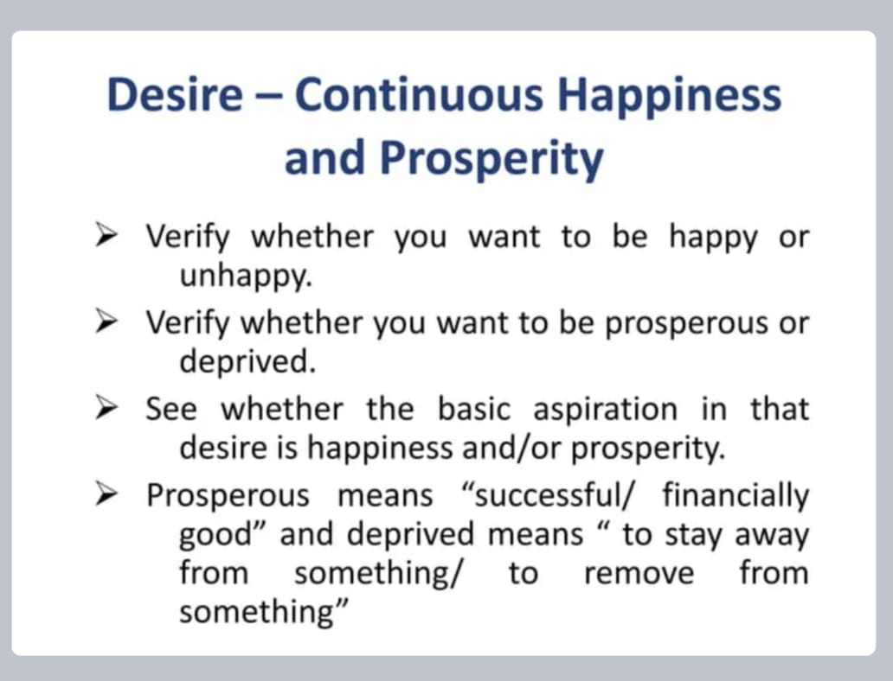

Slide 3


Slide 4
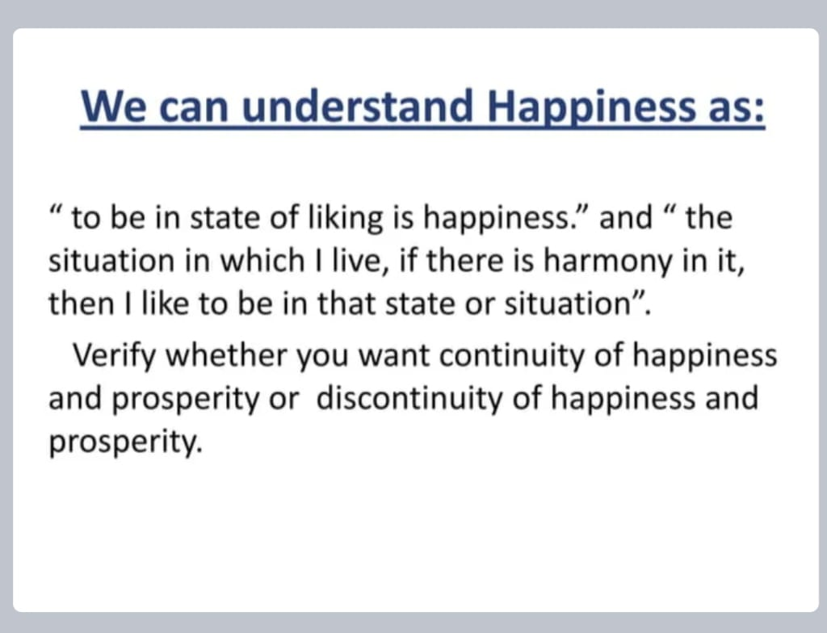

Slide 5
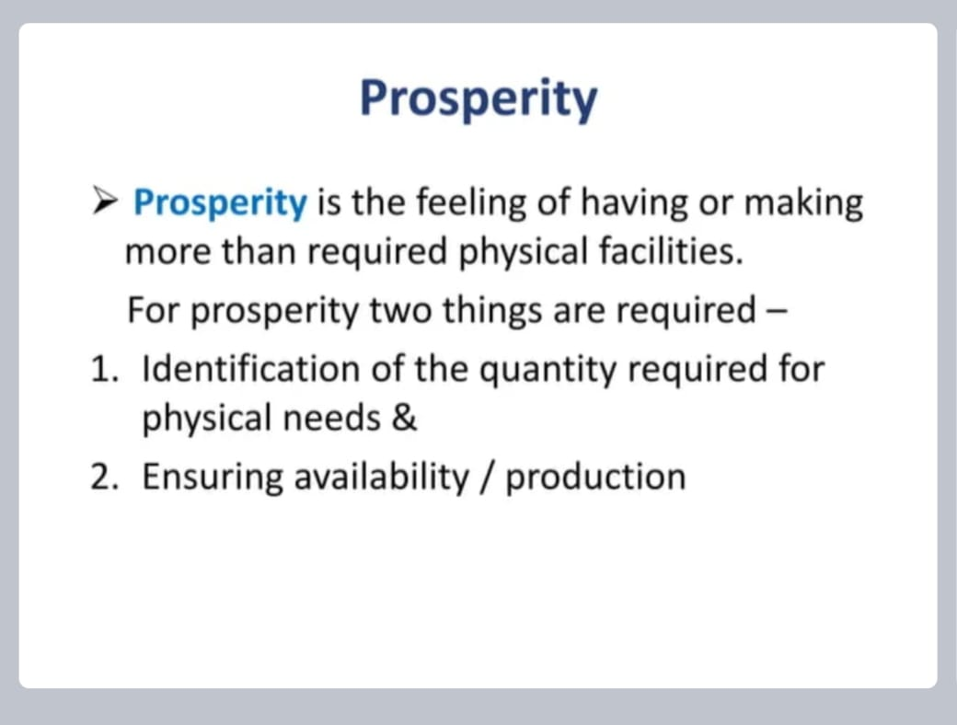

Slide 6
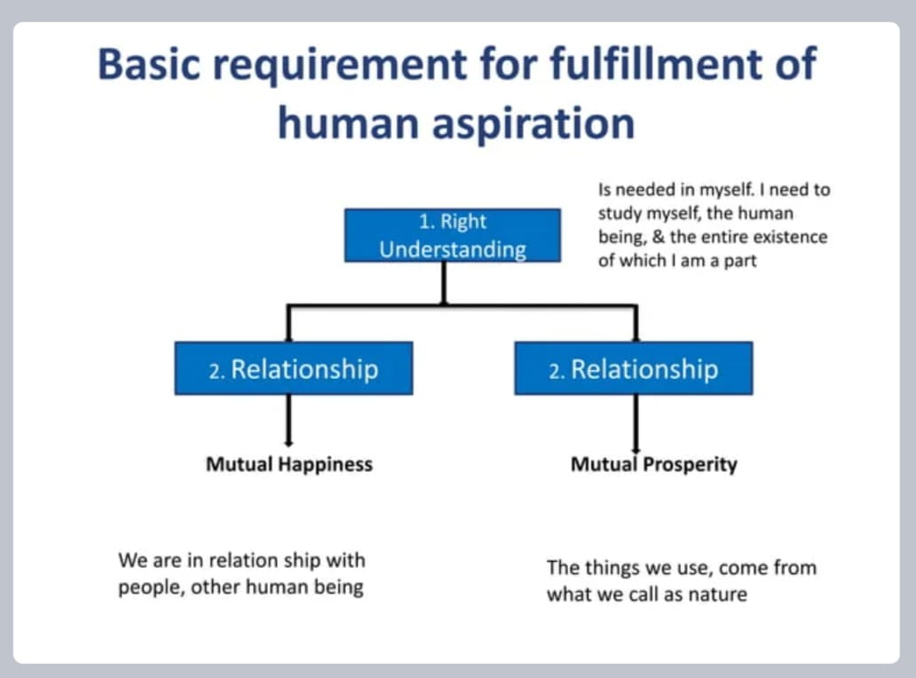

Slide 7
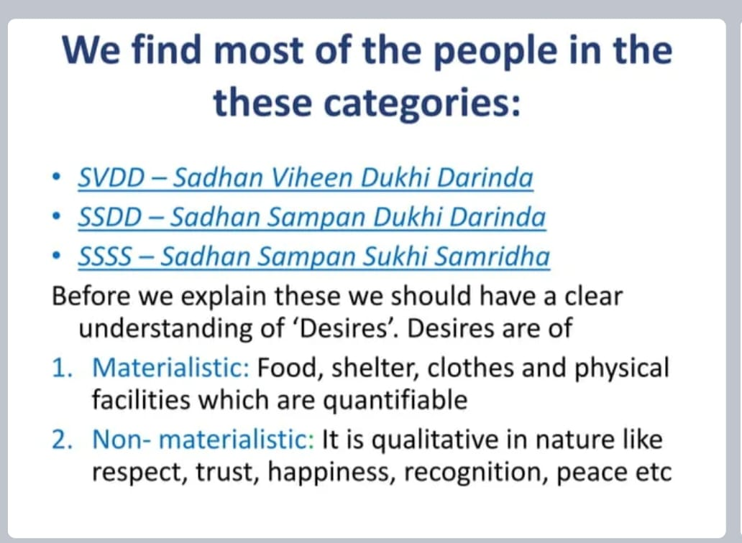

Slide 8
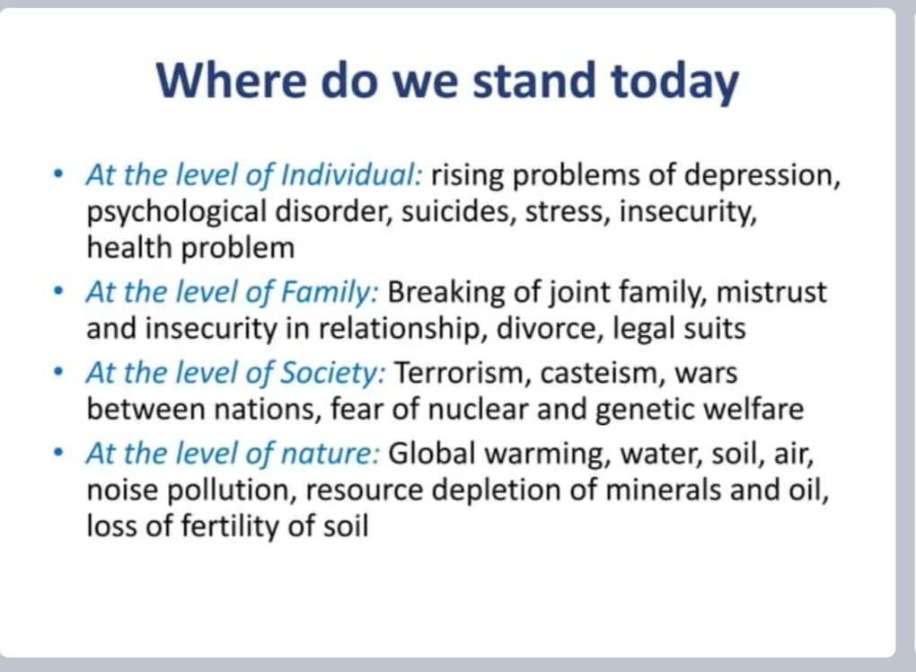

Slide 9
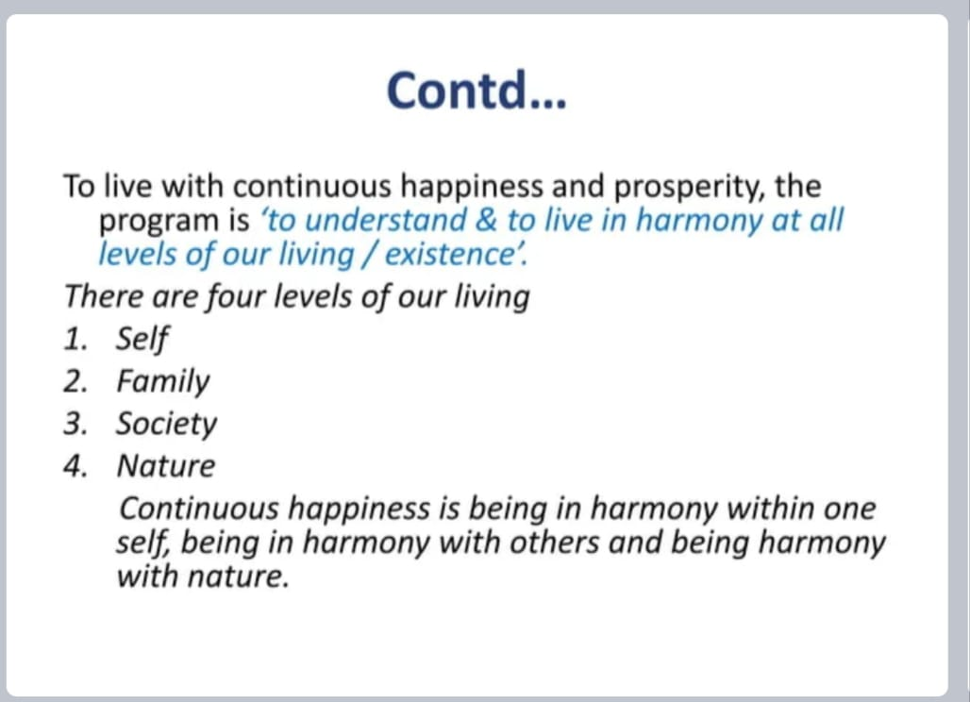

Slide 10


